Slide 1
Datascraping - Golf
Victor Nicolausson

Slide 2
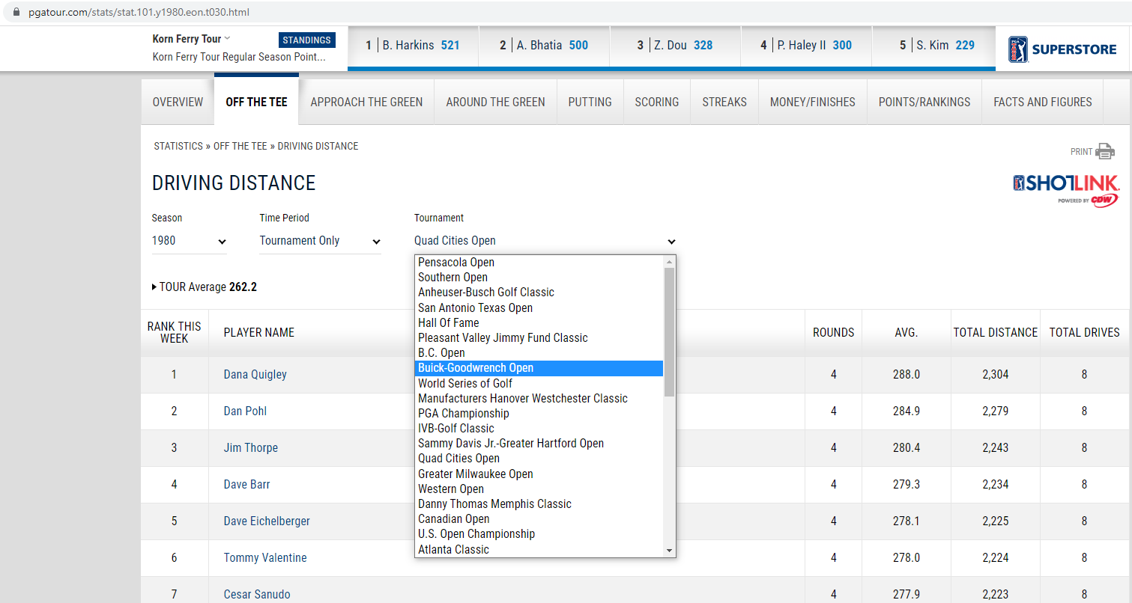
Scraping average driving data from pgatour.com

Slide 3
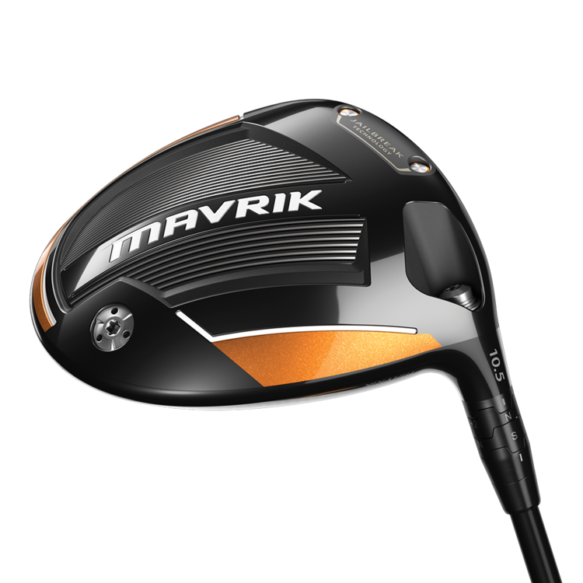
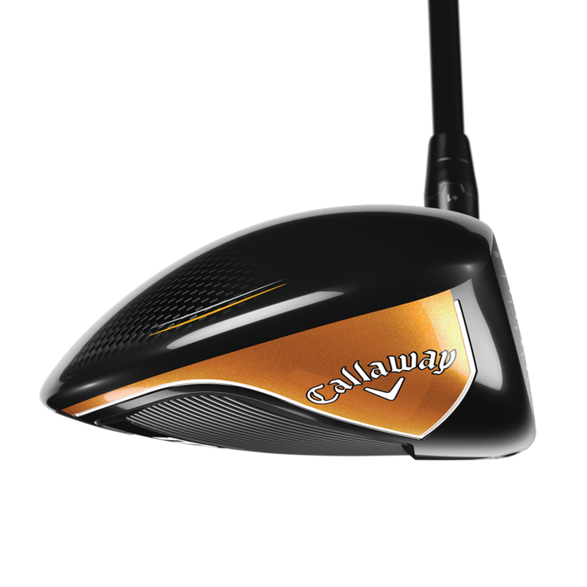
Driver = The big stick / The big dog / The gun
“Let the big dog eat”

Slide 4
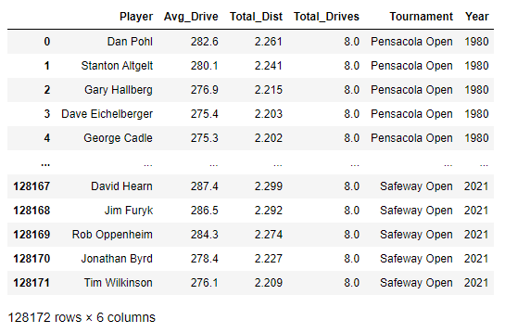
Resulting dataset
128,172 rows
6 values/row
769,032 datapoints

Slide 5
Goals: Visualize data to spot developments and trends
Interesting things to look at:
The change in avg. driving distance / year
Avg number of total drives hit
Avg total distance / year
Does the sample range follow a normal distribution? If so:
How does the standard deviation change?
How much did the top 5% of players develop compared to the bottom 5%?

Slide 6
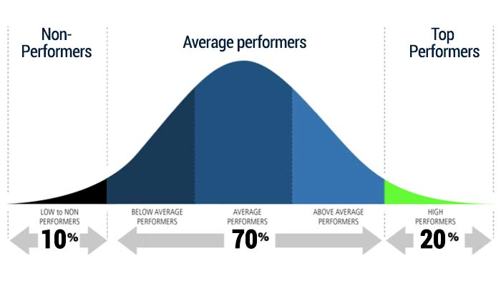
Histograms show the distribution - Normal distr.

Slide 7
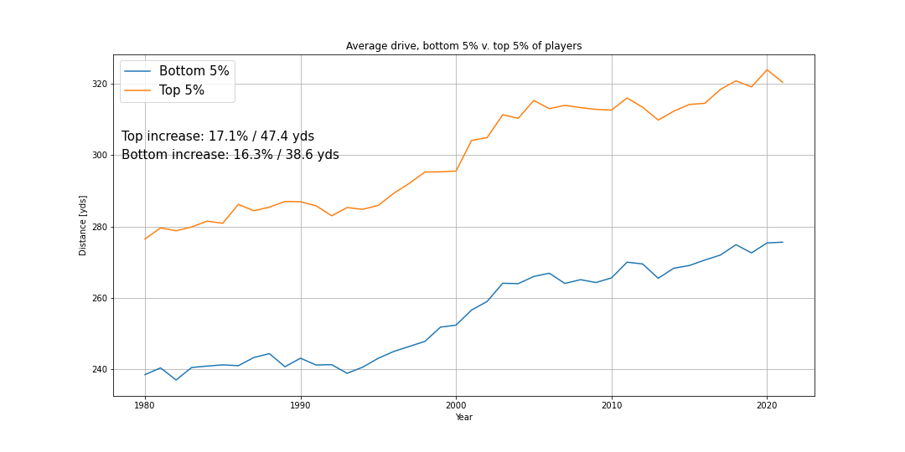
Driving averages, top 5% vs lowest 5%

Slide 8
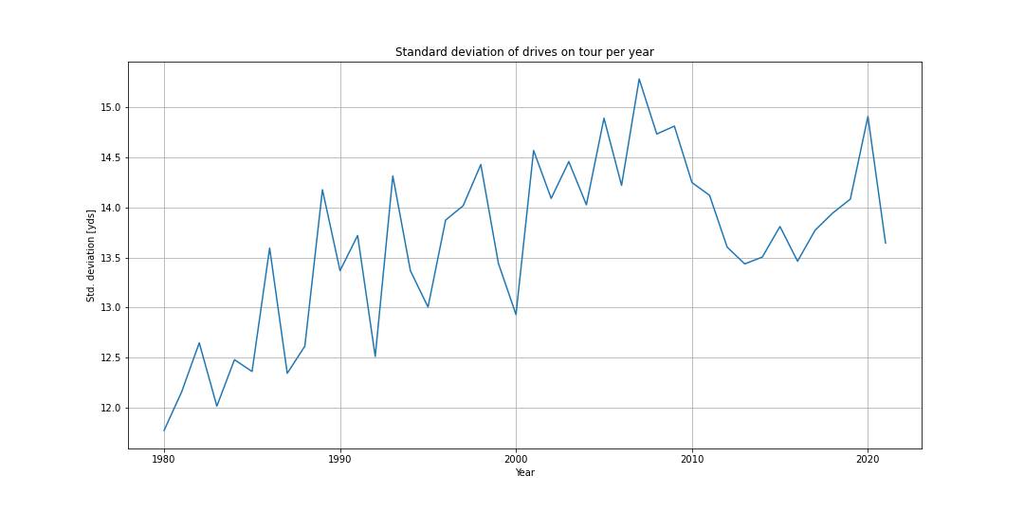
Standard deviation over time, average distance

Slide 9
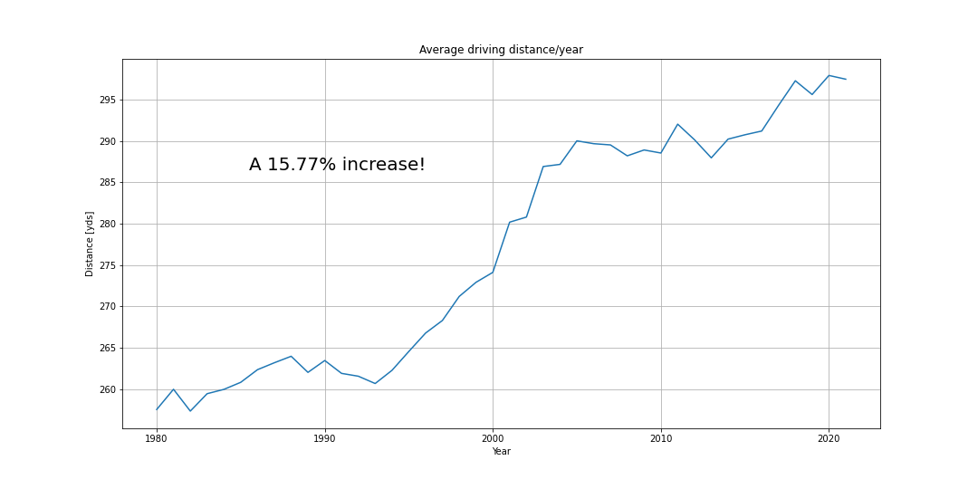
Average driving distance - DataFrame.mean()

Slide 10
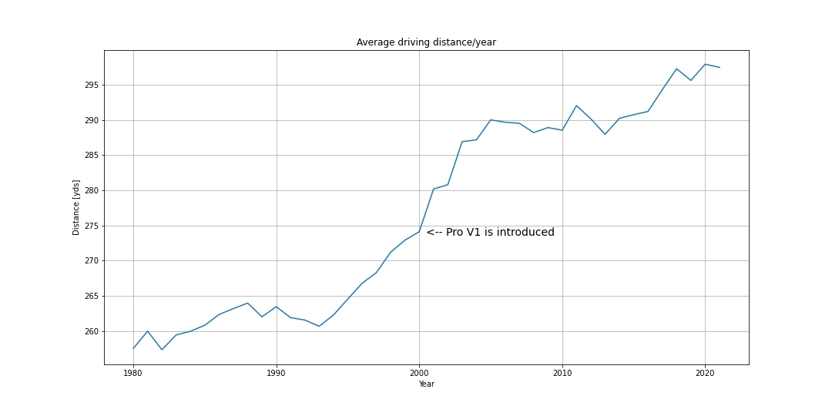
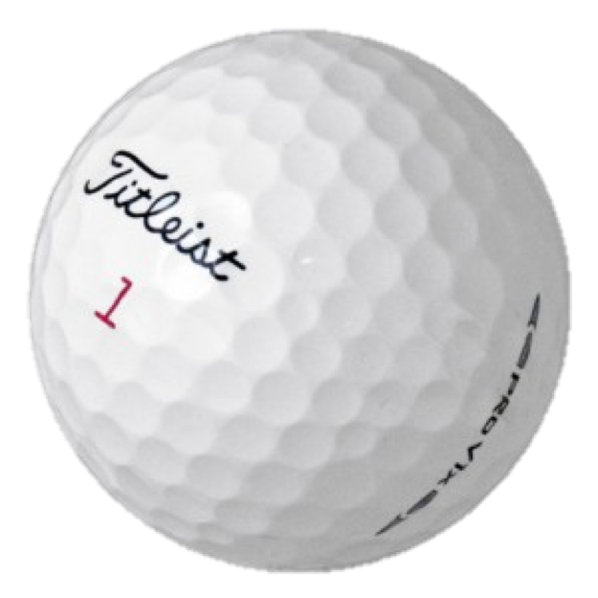
Average driving distance - DataFrame.mean()

Slide 11
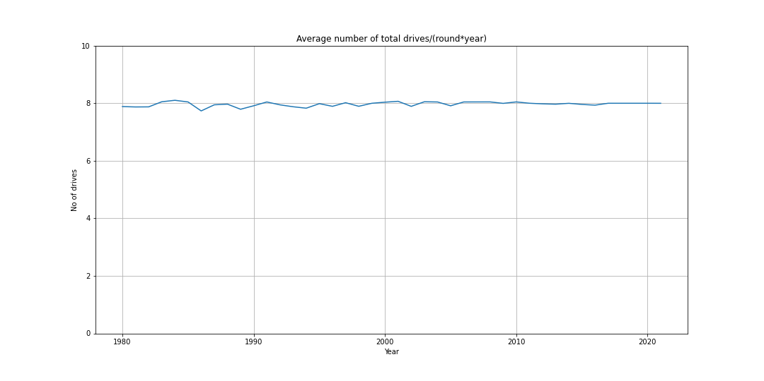
Average number of drives/round*year - DataFrame.mean()

Slide 12
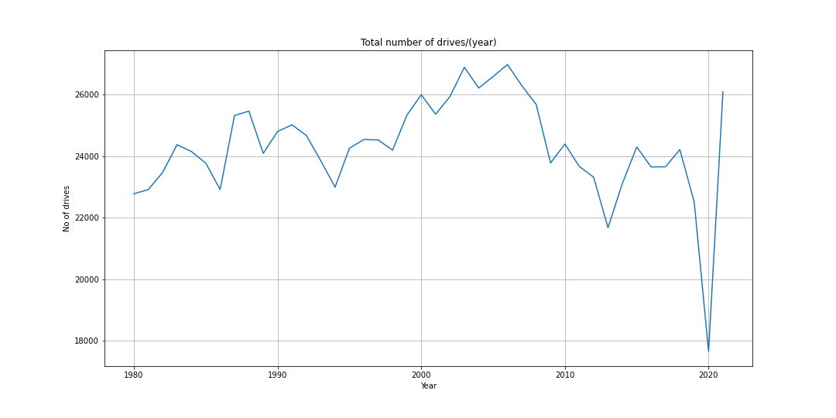
Total number of drives/year

Slide 13
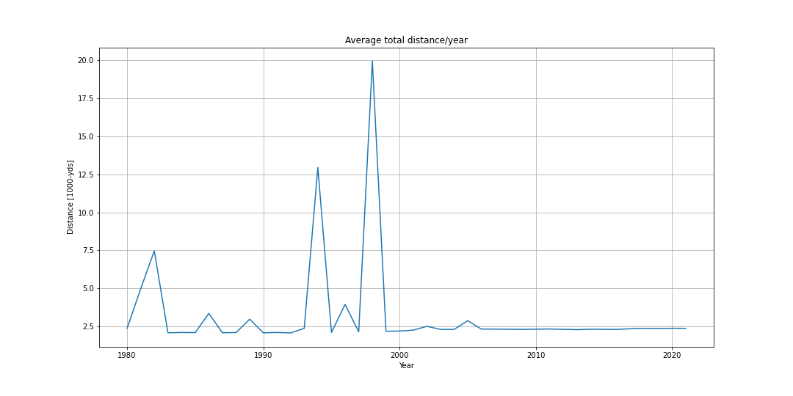
Average total distance - DataFrame.mean()
Needs cleaning
(unit error)
Needs investigation

Slide 14
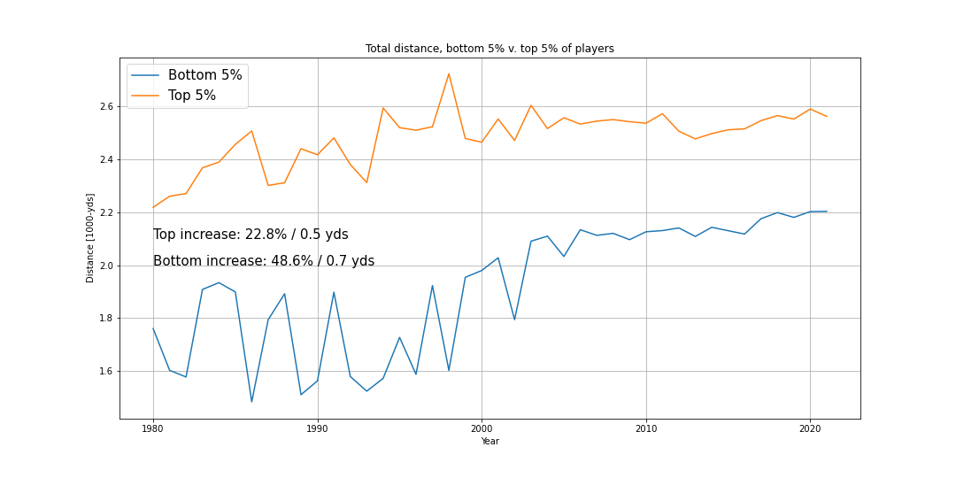
Quantiles, total distance

